Slide 1
CV in Chess: A study on identifying chess boards and pieces with neural networks
July 2024 session
Istrate Liviu
Scientific coordinator: Iftene Adrian

Slide 2
Problem description
Chess: a very popular game that involves strategic thinking and no elements of luck
It is played on an 8x8 grid, with white and black pieces
The players move the pieces until checkmate, where a player’s king cannot escape the opponent’s threat
For many years, chess theories, artistic compositions and new chess rules were evolved, until recently, when it became an influence in the fields of computer science and psychology
Chess competitions are organized since the 19th century, hosted usually by the International Chess Federation (FIDE) and its organizations (NYSCA, FFE, DSB, FRSah)

Slide 3
Problem description
With new technological methods of computer vision, artificial intelligence and machine learning introduced, chess games can be digitized on a computer screen or on mobile devices
Chess computers have been evolving since the 18th century, when The Turk was constructed
Chess engines (Stockfish, GNU Chess, Deep Blue) were developed towards the 1990s, and have become stronger to beat the game’s best players
Portable Game Notation (PGN), released in 1994, is a file that contains the details of a chess game, and its moves in Forsyth-Edwards Notation (FEN)
Schemas of predicting the best possible moves were discussed and helpful methods were brought along – search algorithms, transposition tables, gradient descent, neural networks, etc.

Slide 4
Problem description
Chessboard detection implies using computer vision methods, such as edge detectors, transforms, clustering algorithms, camera calibrations and operating with significant extracted features, like corners and lines
For two-dimensional (2D) chessboards, there are already solutions for recognizing such board that is printed on paper or shown on screen
Applications like Chessvision.ai and Chessify have tools that find these boards from different resources
For three-dimensional (3D) ones otherwise, some of the approaches have been applied, despite other problems that still haven’t been discussed about
The Raspberry Turk is a robot that detects the board through a Raspberry Pi and searches for the best moves
These problems rely on the ones of the technological methods, and also on dataset structures

Slide 5
Solution description
This dissertation thesis explores the possible solutions of digitizing physical chessboards, with respect to the technical methods considered and the types of images discovered in various datasets
Besides these solutions, we take into account the problems of chessboard localization mentioned earlier
Technical methods include: detectors for edges, corners, lines, calibrations, image cropping, types of clustering and neural networks
Considering the recognition of chessboards and their states through images, the recognition through video recordings was questioned; with smoother videos (those with 60 FPS), it could be possible of determining the state of a chessboard from the frames registered in the last circa 2 seconds

Slide 6
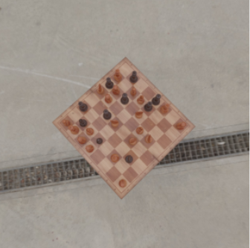
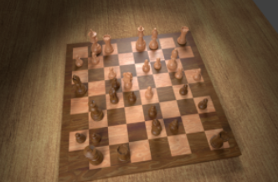
Solution description
This problem implies two ways these images of chessboards are taken – from the top of the board and at an angle above it

Slide 7
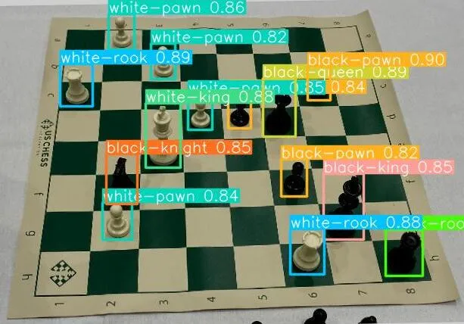
Solution description
Regarding neural networks, we haven’t reached into a conclusion yet, but we have chosen three types of these networks – convolutional, residual and YOLO (You Look Only Once) - that are among those recommended for this task
For convolutional networks, we selected one that has convolutional and max-pooling layers, and the others that are VGG variants, with 16 and 19 layers
The YOLO model has become a popular network for object detection, especially for tackling chess piece recognition problems
There are lots of datasets found on Roboflow made specifically for training this network
Source: Medium

Slide 8
Computer vision techniques
We have selected the following methods useful for localizing physical chessboards:
Edge detectors: Adaptive thresholding and Canny
Harris corner detector
Line detectors: Hough transform – both probabilistic and non-probabilistic versions
From these lines we get the necessary points: from non-probabilistic Hough transform we extract the intersections of the detected lines; from the probabilistic one we extract the endpoints of the found lines
Perspective transformation (for a better view of the board)
Cropping (to zoom the image in to cut off unnecessary lines)

Slide 9
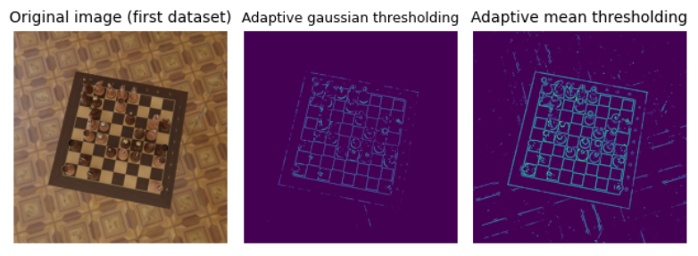
Adaptive thresholding
Manages (partially) to get the edges of the board, but also highlights features from the background
Not a perfect solution as we want to minimize background features

Slide 10
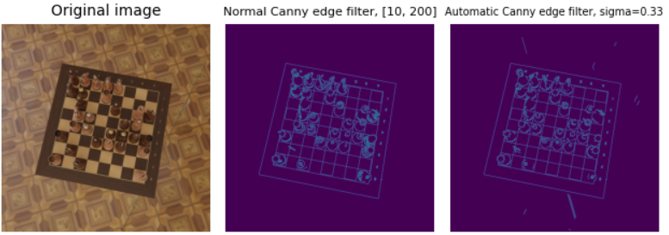
Canny edge detector
With the right threshold interval, this detector highlights the important features of the board without including any of those from the background
There’s also an automatic edge detector that is based on a sigma value; regardless of that value, this variant can identify background features in some cases

Slide 11
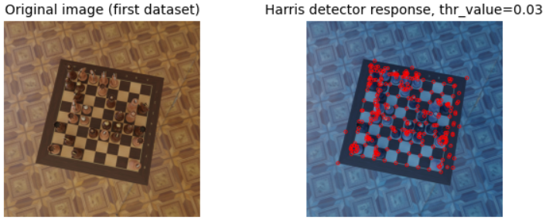
Harris corner detector
This detector does find the corners of a chessboard, but two problems of inexistent corners arise:
The rounded parts of the chess pieces, especially pawns, rooks and bishops, are considered as “corners” by this detector, even though they don’t have any real corners
It doesn’t find all corners of the table, but it could be risky as this could find “corners” from the background

Slide 12
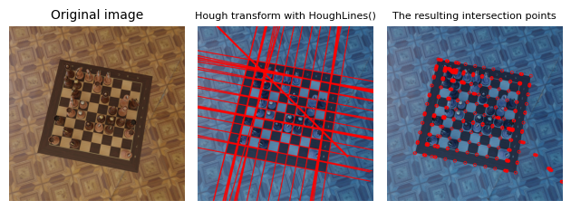
Non-probabilistic Hough transform
This version has the detected lines crossed over the image
From these lines we extract their intersections and select the ones that represent the chessboard corners
Despite some features being detected more than once, this version must have a threshold value moderated to find all the necessary features
Low threshold values come with unnecessary lines (or more doubles), while high values come with the risk of some important features not being found by this transform

Slide 13
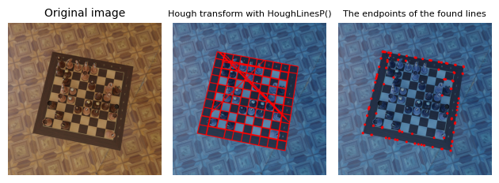
Probabilistic Hough transform
This version is a progressive probabilistic version of the transform, and its results are mostly based on the edges of the Canny filter, depending also on the line length and the gap between the lines
Unlike the previous variant, the lines are limited within the image size
From these we can extract their endpoints and find the corners easily

Slide 14
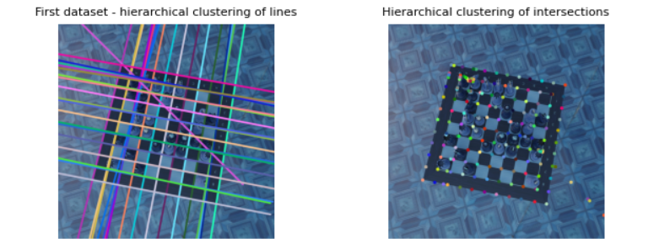
Hierarchical clustering
In some cases, we observe some groups of lines that are close to each other – the only solution would be to cluster them until we get the same number of lines
The same thing could be said when clustering the extracted points

Slide 15
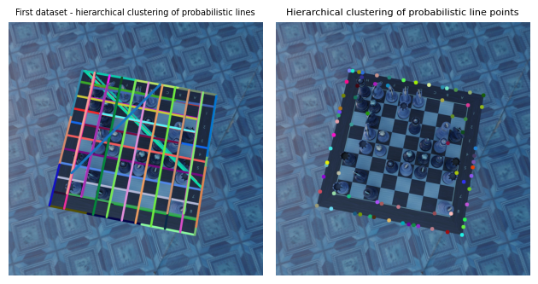
Hierarchical clustering
Doesn’t work as well with the probabilistic Hough transform, albeit it is of no use in the case of chessboard localization

Slide 16
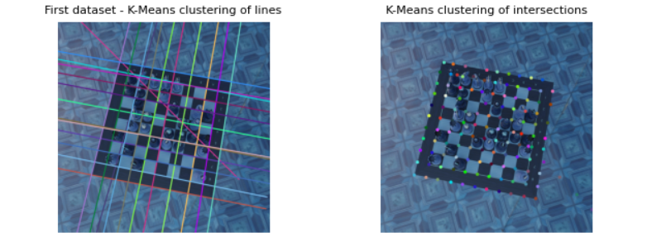
K-Means clustering
Unlike the hierarchical one, K-Means clustering needs an exact number of formed clusters; in this case, we would deal with 22 groups that represent the chessboard lines and table borders (11 vertical, 11 horizontal), or with 121 points that represent its corners
It seems this wouldn’t work because:
Some lines and points are moved a bit away from the actual feature that it represents
the algorithm could risk of not finding the exact number of necessary clusters

Slide 17
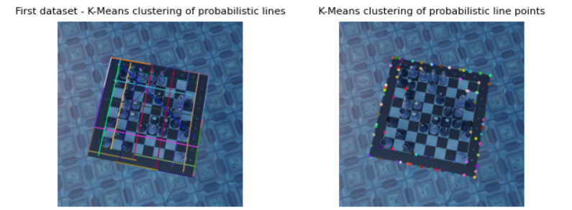
K-Means clustering
Like the hierarchical one, again, it doesn’t work with lines (or points) from probabilistic Hough transform
We notice some lines (or points) being moved away from the features they represent after applying this clustering

Slide 18
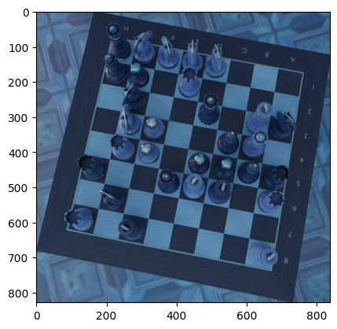
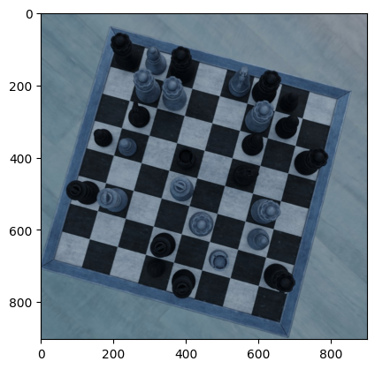
Cropping
Requires classic array segmentation
Useful for zooming the picture in (for another localization)

Slide 19
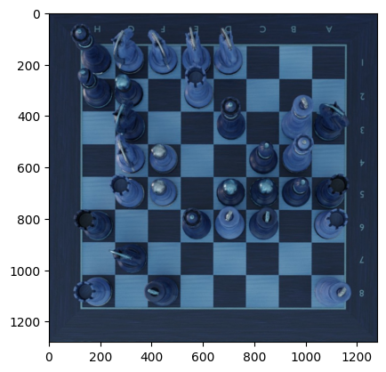
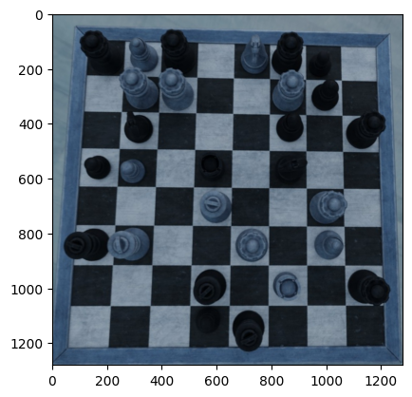
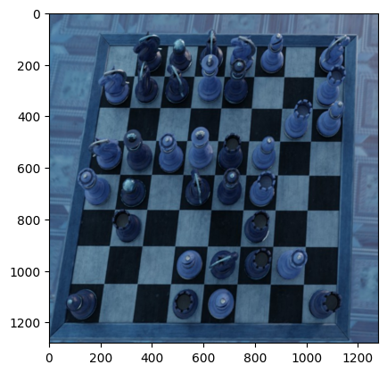
Perspective transformation (warping)
This procedure needs all four points ordered consecutively to produce the new bird’s eye view properly; they are slightly moved to the closest corner to get the pieces in full
The arrangement of these points may even produce a slightly deformed view, despite the pieces (and empty squares) being fully visible; this would involve new challenges for identifying chess states and splitting the images for training

Slide 20
Conclusions regarding chessboard localization
This task can be resolved by changing the threshold values for both detectors, without needing any clustering of features
This process can help in adding more details related to a chessboard’s coordinates in datasets
Considering the points extracted from the lines we have found, the algorithm selects four points where each of them are the closest to a corner of an image
The respective image is either cropped or has its perspective transformed, depending upon if all four points found can form a proper quadrilateral
Both versions of Hough transform can give the necessary features for this localization, depending on the edges found by the Canny algorithm, despite some of the cases having the found corners being placed “inside” the chessboard, leaving with a missing row or column
For images taken in a dark place with a flash, some areas affected by the flash would make the edge detector generate particles, which would lead to a number of inexistent lines caused by this

Slide 21
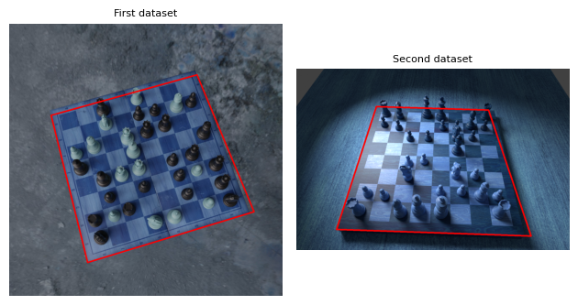
Conclusions regarding chessboard localization
For chessboards captured from the top, some of them can have its perspective transformed (sometimes with a few threshold value changes), others need to be cropped to eliminate occluding features
The found points must form a square
For chessboards captured from an angle above them, their perspective can be easily warped, without cropping
In this case, the points form a trapezoid

Slide 22
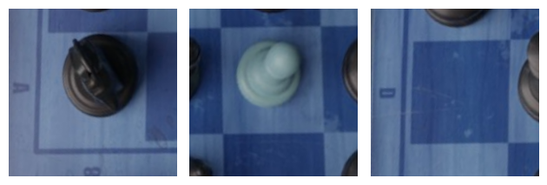
Conclusions about generating chess piece data
Having obtained a new view of a chessboard, we would further split the image into 64 samples (one for each square) for every state
An intention would be to stock the generated chess piece images in the same way as in MNIST – a variable would have the images and the other the name of the respective chess pieces

Slide 23
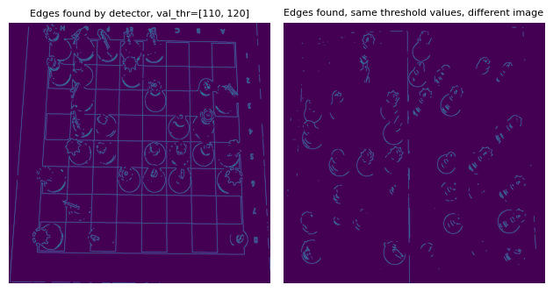
Conclusions about generating chess piece data
To create these images, we are using the same methods used for chessboard localization, including hierarchical clustering
Now that we work with close-ups of these chessboards, the Canny filter must use a smaller threshold interval; again, not all chessboards work with the same values, so they need to be changed until we get enough features

Slide 24
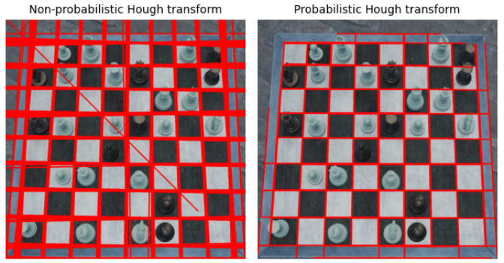
Conclusions about generating chess piece data
Both versions of Hough transform are useful for identifying the corners
The non-probabilistic version generates a lot of lines that represent a significant feature, which clustering helps into reducing them
Meanwhile, from the probabilistic version we extract the endpoints, which are further selected to represent the chessboard corners

Slide 25
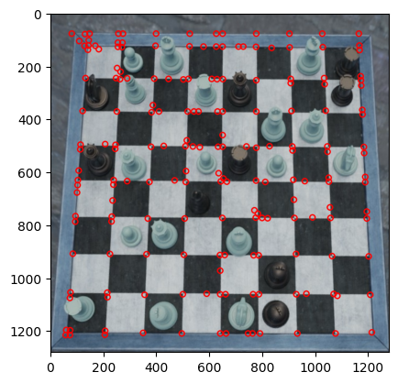
Conclusions about generating chess piece data – first method
A method of extracting the images representing every chess square would be to use the obtained intersections to generate the images of a state
Thus, these points serve as the south-west corner of each generated image
Some points close to each other would create doubles of chess square images
It would take a lot of time to create the images using these, unless we filter out the ones that are close to the ends of the image
Besides, this would generate the images correctly, despite the need to cut out doubles or improper ones

Slide 26
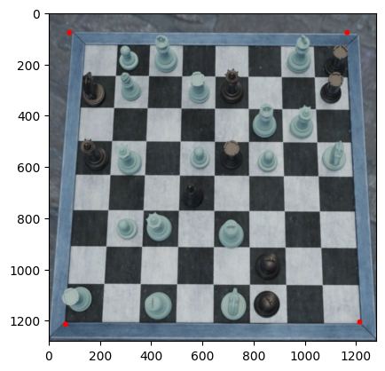
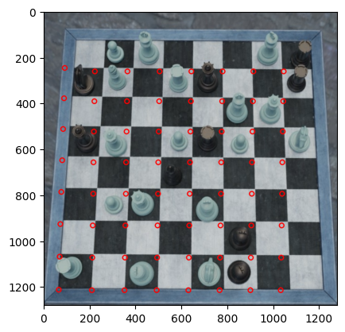
Conclusions about generating chess piece data – second method
The other method would be to select a detected corner and create a pattern of points starting from it
This method would need more complex operations to get the pattern match with the chessboard corners
Despite this problem, there are no duplicates of chess piece images created

Slide 27

Neural networks – the progress so far
The standard convolutional network would be modeled with convolutional layers and max-pooling ones, with other versions that have batch normalization or layer normalization
The VGG and Resnet models would be tested with batch normalization
For the YOLO network, it needs a YAML file that contains the classes and the dataset’s paths
The only problem is it needs the dataset to be in a specific format – with annotations done with Roboflow
Roboflow Universe has most datasets made specifically for training with YOLO networks

Slide 28
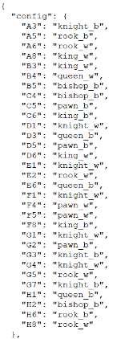
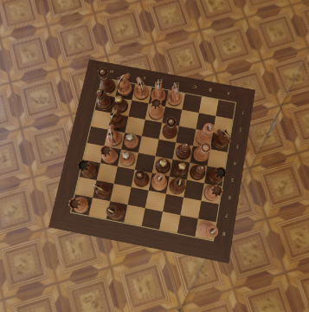
Dataset problems
There are more datasets of chessboards that are computer generated (2D, with images provided from either Lichess or Chess.com) than those of real chessboards (3D)
About 3D chessboards, some of these datasets have too few important details – the corners of the table and their states (either stocked in JSON or in FEN format)
If these actually have details of chess states, the algebraic notation starts from different points instead of a single point (usually on the SW quarter of the image)

Slide 29
Contributions
Using these localization methods with other board games – checkers, Go, etc.
Improvements of chessboard datasets with additional information
Integration with mobile applications – imagine an app like Office Lens that localizes chessboards, including the possibility to drag the found points properly to the board corners
A set of rules to apply for identifying chessboards and their states
Benchmarking neural networks in advance

Slide 30
Thank you for your attention!
CV in Chess: A study on identifying chess boards and pieces with neural networks - Liviu Istrate
July 2024 session

